Slide 1
Structuring Industrial Security Standards for Machine-Readable Analysis
Dipan Banerjee
Notes:
1

Slide 2
Problem Statement
2
07.11.2019
Challenge: Security standards exist as long-form PDF documents with complex hierarchies.
Problem: Difficult to query, not machine readable
Goal: Convert unstructured data to structure format for machine readable purpose.
Scope- BSI-200 standards, IEC62443, NIST82r3
Notes:
2

Slide 3
Some Surveys
3
07.11.2019
Automatic extraction of requirements expressed in industrial standards: a way towards machine readable standards? | Extracted requirements from a standards document using semantic analysis, manual/semi-automatic extraction, ontology building, and structured indexing.
Requirements Extraction using Large Language Models / Digital Transformation of Security Standards: Requirements Extraction using Large Language Models. | Used fine-tuned LLMs such as BERT, T5, and BART to identify and extract security requirements from standards.
Notes:
3

Slide 4
BSI Standard 2001 : ISMS Lifecycle
4
07.11.2019
PDCA Cycle:
Plan: Define security objectives and strategy
Do: Implement security concept and measures
Check: Review effectiveness and compliance
Act: Improve and optimize
Notes:
4

Slide 5
NIST Operational Technology
5
07.11.2019
Five Core Functions
Identify: Understand cyber risks
Protect: Safeguard critical assets
Detect: Monitor for incidents
Respond: Act on detected events
Recover: Restore normal operations
Notes:
5

Slide 6
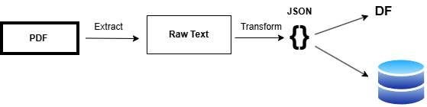
ETL Architecture
6
07.11.2019
Notes:
6

Slide 7
Transformation: NLP Classification
7
07.11.2019
Method: TF-IDF vectorization + cosine similarity
Input: Text segments from extracted PDFs
Process: Compare text against lifecycle phase descriptions
Output: Assigned lifecycle phase (Plan, Do, Check, Act) or (Identify, Protect, Detect, Respond, Recover)
Benefit: Automatic classification without manual tagging
Notes:
7

Slide 8
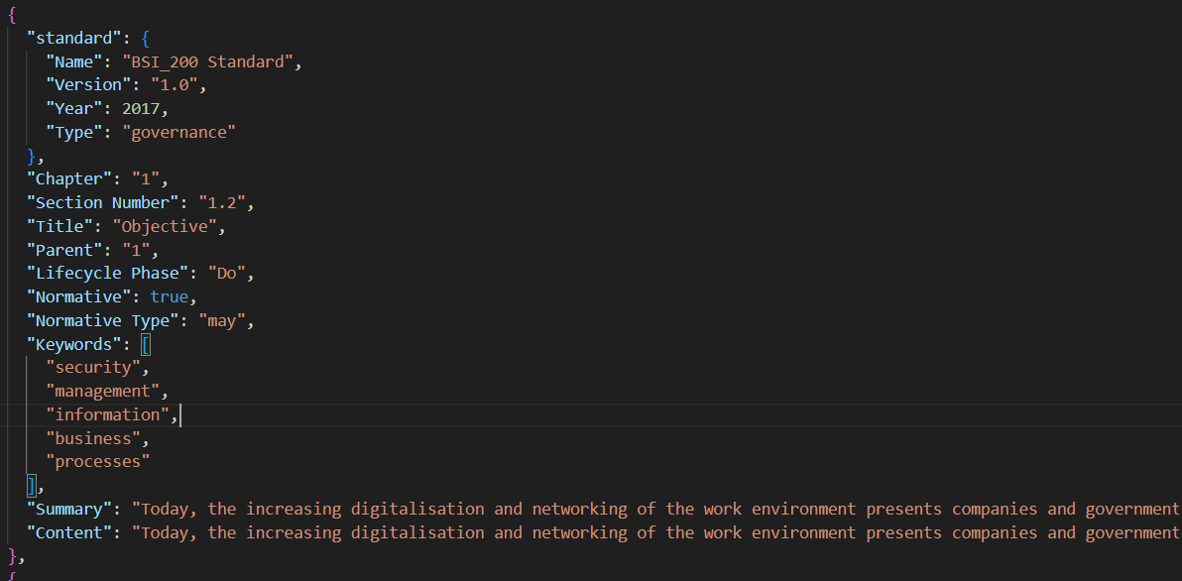
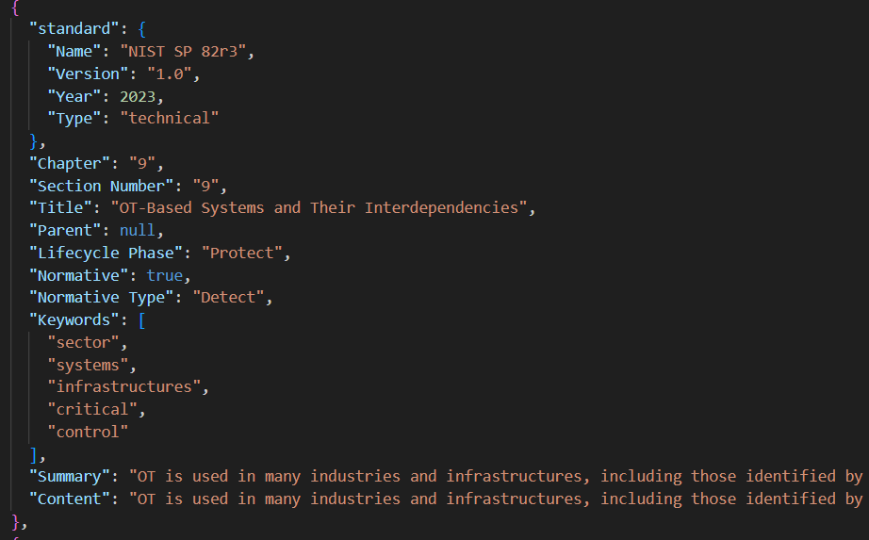
JSON Output
8
07.11.2019
BSI JSON
NIST JSON
Notes:
8

Slide 9
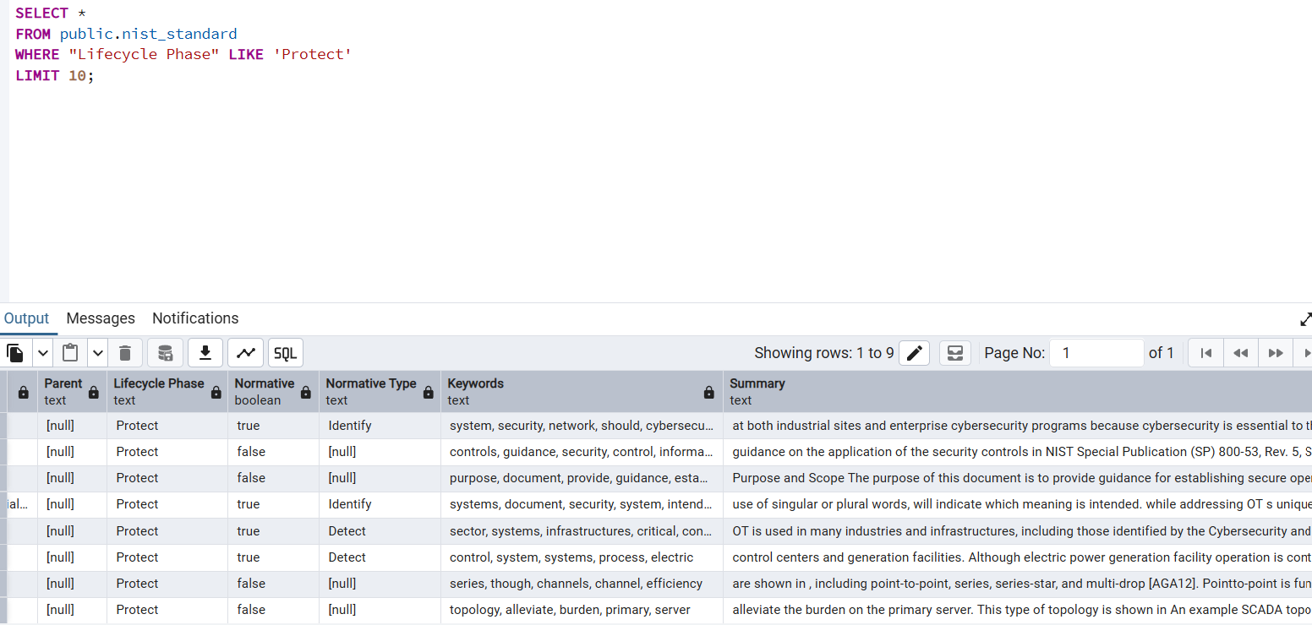
Database Integration
9
07.11.2019
Notes:
9

Slide 10
Possible Use Cases
10
07.11.2019
Use Cases | Users | Technologies
Automated Security Requirement Generation | Security Engineers | LLM, Requirement Documents
Interactive Query System | Students, Teachers | Database, APIs
Compliance Gap Analysis | Cybersecurity Analyst, Data Engineers | Database, PowerBI
Automate Test Case Generation | Consultants, Managers | Web Application– Flask or Django
Notes:
10

Slide 11
Things need to be discussed
11
07.11.2019
IEC62443 – cannot be scraped because of copyright licensing.
Validating the database.
More standards like ITIL can be incorporated.
Discussion on interactive dashboard with LLM(RAG) Applications.
Notes:
11

Slide 12
References
12
07.11.2019
Automatic extraction of requirements expressed in industrial standards: a way towards machine readable standards?
Requirements Extraction using Large Language Models / Digital Transformation of Security Standards: Requirements Extraction using Large Language Models.
Notes:
12

